Slide 1
UNIT-III
Relations and Their Properties

Slide 2
Relations
Binary relations represent relationships between the elements of two sets.
A binary relation R from set A to set B is defined by: R ⊆ A × B
If (a,b) ∈ R, we write:
  aRb (a is related to b by R)
If (a,b) ∉ R, we write:
  aRb (a is not related to b by R)
/

Slide 3
Relations
A relation is represented by a set of ordered pairs
If A = {a, b} and B = {1, 2, 3}, then a relation R₁ from A to B might be, for example, R₁ = {(a, 2), (a, 3), (b, 2)}.
The first element in each ordered pair comes from set A, and the second element in each ordered pair comes from set B.

Slide 4
Example:
A = {0,1,2}
B = {a,b}
A × B = {(0,a), (0,b), (1,a), (1,b), (2,a), (2,b)}
Then R = {(0,a), (0,b), (1,a), (2,b)} is a relation from A to B.
  Can we write 0Ra ?
  Can we write 2Rb ?
  Can we write 1Rb ?

Slide 5
Example
A relation may be represented graphically or as a table:
R | a | b
0 | X | X
1 | X
2 |  | X
0
1
2
a
b
We can see that 0Ra but 1Rb.
/

Slide 6
Functions as Relations
A function is a relation that has the restriction that each element of A can be related to exactly one element of B.
Relation
Function
1
a
1
a
b
b

Slide 7
Relations on a Set
Relations can also be from a set to itself.
A relation on the set A is a relation from set A to set A, i.e., R ⊆ A × A
Let A = {1, 2, 3, 4}
Which ordered pairs are in the relation R = {(a,b) | a divides b}?
;R = {(1,1), (1,2), (1,3), (1,4), (2,2), (2,4), (3,3), (4,4)}

Slide 8
Relations on a Set
Which of these relations (on the set of integers) contain each of the pairs (1,1), (1,2), (2,1), (1,-1), and (2,2)?
  R₁ = {(a,b) | a ≤ b}
  R₂ = {(a,b) | a > b}
  R₃ = {(a,b) | a = b, a = −b}
  R₄ = {(a,b) | a = b}
  R₅ = {(a,b) | a = b + 1}
  R₆ = {(a,b) | a + b ≤ 3}
Notes:
(1,1) is in R1, R3, R4, and R6. (1,2) is in R1 and R6. (2,1) is in R2, R5, and R6. (-1,1) is in R2, R3, and R6. (2,2) is in R1, R3, and R4.

Slide 9
Relations on a Set
The pair (1,1) is in R₁, R₃, R₄ and R₆
The pair (1,2) is in R₁ and R₆
The pair (2,1) is in R₂ , R₅ and R₆
The pair (1,-1) is in R₂ , R₃ and R₆
The pair (2,2) is in R₁ , R₃ and R₄
Notes:
(1,1) is in R1, R3, R4, and R6. (1,2) is in R1 and R6. (2,1) is in R2, R5, and R6. (-1,1) is in R2, R3, and R6. (2,2) is in R1, R3, and R4.

Slide 10
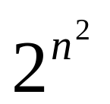
Relations on a Set
How many relations are there on a set with n elements?
If A has n elements, how many elements are there in A × A?
n²
Notes:
(1,1) is in R1, R3, R4, and R6. (1,2) is in R1 and R6. (2,1) is in R2, R5, and R6. (-1,1) is in R2, R3, and R6. (2,2) is in R1, R3, and R4.

Slide 11
Relations on a Set
How many relations are there on set S = {a, b, c}?
There are 3 elements in set S, so S × S has 3² = 9 elements.
Therefore, there are 2⁹ = 512 different relations on the set S = {a, b, c}.
Notes:
(1,1) is in R1, R3, R4, and R6. (1,2) is in R1 and R6. (2,1) is in R2, R5, and R6. (-1,1) is in R2, R3, and R6. (2,2) is in R1, R3, and R4.

Slide 12
Properties of Relations
Let R be a relation on set A.
R is reflexive if:
(a, a) ∈ R for every element a ∈ A.

Slide 13
Example
Determine the properties of the following relations on {1, 2, 3, 4}
Which of these is reflexive?
  R₁ = {(1,1), (1,2), (2,1), (2,2), (3,4), (4,1), (4,4)}
  R₂ = {(1,1), (1,2), (2,1)}
  R₃ = {(1,1), (1,2), (1,4), (2,1), (2,2), (3,3), (4,1), (4,4)}
  R₄ = {(2,1), (3,1), (3,2), (4,1), (4,2), (4,3)}
  R₅ = {(1,1), (1,2), (1,3), (1,4), (2,2), (2,3), (2,4), (3,3), (3,4), (4,4)}
  R₆ = {(3,4)}
The relations R₃ and R₅ are reflexive because they contain all pairs of the form (a,a); the other don’t [they are all missing (3,3)].

Slide 14
Properties of Relations
Let R be a relation on set A.
R is symmetric if:
(b, a) ∈ R whenever (a, b) ∈ R, where a, b ∈ A.
A relation is symmetric iff “a is related to b” implies that “b is related to a”.

Slide 15
Example
Which of these is symmetric?
  R₁ = {(1,1), (1,2), (2,1), (2,2), (3,4), (4,1), (4,4)}
  R₂ = {(1,1), (1,2), (2,1)}
  R₃ = {(1,1), (1,2), (1,4), (2,1), (2,2), (3,3), (4,1), (4,4)}
  R₄ = {(2,1), (3,1), (3,2), (4,1), (4,2), (4,3)}
  R₅ = {(1,1), (1,2), (1,3), (1,4), (2,2), (2,3), (2,4), (3,3), (3,4), (4,4)}
  R₆ = {(3,4)}
The relations R₂ and R₃ are symmetric because in each case (b,a) belongs to the relation whenever (a,b) does.
The other relations aren’t symmetric.

Slide 16
Properties of Relations
Let R be a relation on set A.
R is antisymmetric if whenever (a, b) ∈ R and (b, a) ∈ R, then a = b, where a, b ∈ A.
A relation is antisymmetric iff there are no pairs of distinct elements with a related to b and b related to a. That is, the only way to have a related to b and b related to a is for a and b to be the same element.
Symmetric and antisymmetric are NOT exactly opposites.

Slide 17
Example
Which of these is antisymmetric?
  R₁ = {(1,1), (1,2), (2,1), (2,2), (3,4), (4,1), (4,4)}
  R₂ = {(1,1), (1,2), (2,1)}
  R₃ = {(1,1), (1,2), (1,4), (2,1), (2,2), (3,3), (4,1), (4,4)}
  R₄ = {(2,1), (3,1), (3,2), (4,1), (4,2), (4,3)}
  R₅ = {(1,1), (1,2), (1,3), (1,4), (2,2), (2,3), (2,4), (3,3), (3,4), (4,4)}
  R₆ = {(3,4)}
The relations R₄, R₅ are antisymmetric because there is no pair of elements a and b with a ≠ b such that both (a,b) and (b,a) belong to the relation.
The other relations aren’t antisymmetric.

Slide 18
Properties of Relations
Let R be a relation on set A.
R is transitive if whenever (a ,b) ∈ R and (b, c) ∈ R, then (a, c) ∈ R, where a, b, c ∈ A.

Slide 19
Example
Which of these is transitive?
  R₁ = {(1,1), (1,2), (2,1), (2,2), (3,4), (4,1), (4,4)}
  R₂ = {(1,1), (1,2), (2,1)}
  R₃ = {(1,1), (1,2), (1,4), (2,1), (2,2), (3,3), (4,1), (4,4)}
  R₄ = { (2,1), (3,1), (3,2), (4,1), (4,2) , (4,3)}
  R₅ = {(1,1), (1,2), (1,3), (1,4), (2,2), (2,3), (2,4), (3,3), (3,4), (4,4)}
  R₆ = {(3,4)}
The relations R₄, R₅ are transitive because if (a,b) and (b,c) belong to the relation, then (a,c) does also.
The other relations aren’t transitive.

Slide 20
Combining Relations
Relations from A to B are subsets of A × B.
For example, if A = {1, 2} and B= {a, b}, then
A × B = {(1, a), (1, b), (2, a), (2, b)}
Two relations from A to B can be combined in any way that two sets can be combined. Specifically, we can find the union, intersection, exclusive-or, and difference of the two relations.

Slide 21
Combining Relations
Let A = {1, 2, 3} and B= {1, 2, 3, 4}, and suppose we have the relations:
R₁ = {(1,1), (2,2), (3,3)} , and
R₂ = {(1,1), (1,2), (1,3), (1,4)}.
Then we can find the union, intersection, and difference of the relations:
R₁ ∪ R₂ = {(1,1), (1,2), (1,3), (1,4), (2,2), (3,3)}
R₁ ∩ R₂ = {(1,1)}
R₁ - R₂ = {(2,2), (3,3)}
R₂ - R₁ = {(1,2), (1,3), (1,4)}

Slide 22
Composition of Relations
If R₁ is a relation from A to B and R₂ is a relation from B to C, then the composition of R₁ with R₂ (denoted R₁ □ R₂) is the relation from A to C.
  If (a, b) is a member of R₁ and (b, c) is a member of R₂, then (a, c) is a member of R₁ □ R₂, where a ∈ A, b ∈ B, c ∈ C.

Slide 23
Example
Let
  A={a,b,c}, B={w,x,y,z}, C={A,B,C,D}
  R₁={(a,z),(b,w)}, R₂={(w,B),(w,D),(x,A)}
Find R1o R2
{ (b,B),(b,D)}

Slide 24
Example
Given the following relations, find S □ R :
  R = {(1,1), (1,4), (2,3), (3,1), (3,4)}
  S = {(1,0),(2,0), (3,1), (3,2), (4,1)}
Construct the ordered pairs in S □ R :
S □ R ={(3,1),(3,4),(3,3)(4,1),(4,4)}

Slide 25
The Powers of a Relation
The powers of a relation R are recursively defined from the definition of a composite of two relations.
Let R be a relation on the set A. The powers R^{n}, for n = 1, 2, 3, … are defined recursively by:
R¹ = R
R^{n+1} = R^{n} □ R
  So:
  R² = R □ R
  R³ = R² □ R = (R □ R) □ R)
  etc.

Slide 26
The Powers of a Relation
Let R = {(1,1), (2,1), (3,2), (4,3)}
Find the powers R^{n} , where n = 1, 2, 3, 4, …
R¹ = R = {(1,1), (2,1), (3,2), (4,3)}
R² = R □ R = {(1,1), (2,1), (3,1), (4,2)}
R³ = R² □ R = {(1,1), (2,1), (3,1), (4,1)}
R⁴ = R³ □ R = {(1,1), (2,1), (3,1), (4,1)}
R⁵ = R⁴ □ R = {(1,1), (2,1), (3,1), (4,1)}

Slide 27
Representing Relations

Slide 28
Representing Relations Using Matrices
Let R be a relation from A to B
  A = {a₁, a₂, … , a_{m}}
  B = {b₁, b₂, … , b_{n}}
The zero-one matrix representing the relation R has a 1 as its (i, j) entry when a_{i} is related to b_{j} and a 0 in this position if a_{i} is not related to b_{j}.

Slide 29
Example
Let R be a relation from A to B
  A={a, b, c}
  B={d, e}
  R={(a, d), (b, e), (c, d)}
Find the relation matrix for R

Slide 30
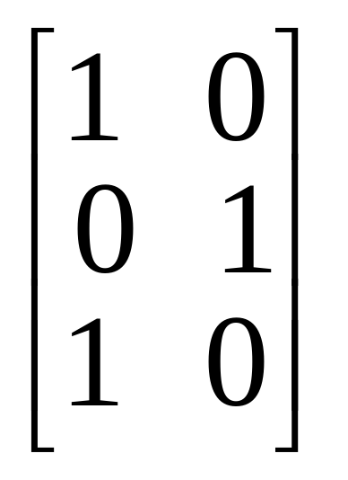
Relation Matrix
Let R be a relation from A to B
  A={a, b, c}
  B={d, e}
  R={(a, d), (b, e), (c, d)}
Note that A is represented by the rows and B by the columns in the matrix.
Cell_{ij} in the matrix contains a 1 iff a_{i} is related to b_{j}.

Slide 31
Relation Matrices and Properties
Let R be a binary relation on a set A and let M be the zero-one matrix for R.
  R is reflexive iff M_{ii} = 1 for all i
  R is symmetric iff M is a symmetric matrix, i.e., M = M^{T}
  R is antisymmetric if M_{i j}= 0 or M_{ji} = 0 for all i ≠ j

Slide 32
Example
Suppose that the relation R on a set is represented by the matrix M_{R}.
⎡
1
1
0
⎤
⎢
⎥
M
=
1
1
1
R
⎢
⎥
⎢
0
1
1
⎥
⎣
⎦
Is R reflexive, symmetric, and / or antisymmetric?

Slide 33
Example
⎡
1
1
0
⎤
Is R reflexive?
Is R symmetric?
Is R antisymmetric?
⎢
⎥
M
=
1
1
1
R
⎢
⎥
⎢
0
1
1
⎥
⎣
⎦
All the diagonal elements = 1, so R is reflexive.
The lower left triangle of the matrix = the upper right triangle, so R is symmetric.
To be antisymmetric, it must be the case that no more than one element in a symmetric position on either side of the diagonal = 1. But M₂₃ = M₃₂ = 1. So R is not antisymmetric.

Slide 34
Representing Relations Using Digraphs
Represent:
  each element of the set by a point
  each ordered pair using an arc with its direction indicated by an arrow

Slide 35
Representing Relations Using Digraphs
A directed graph (or digraph) consists of a set V of vertices (or nodes) together with a set E of ordered pairs of elements of V called edges (or arcs).
The vertex a is called the initial vertex of the edge (a, b).
The vertex b is called the terminal vertex of the edge (a, b).

Slide 36
Example
Let R be a relation on set A
  A={a, b, c}
  R={(a, b), (a, c), (b, b), (c, a), (c, b)}.
Draw the digraph that represents R
a
b
c

Slide 37
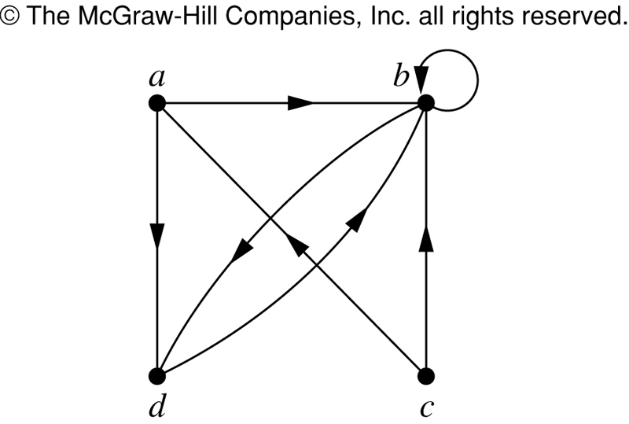
Representing Relations Using Digraphs
This is a digraph with:
V = {a, b, c}
E = {(a, b), (a, d), (b, b),
(b, d), (c, a), (c, b), (d, b)}
Note that edge (b, b) is represented using an arc from vertex b back to itself. This kind of an edge is called a loop.

Slide 38
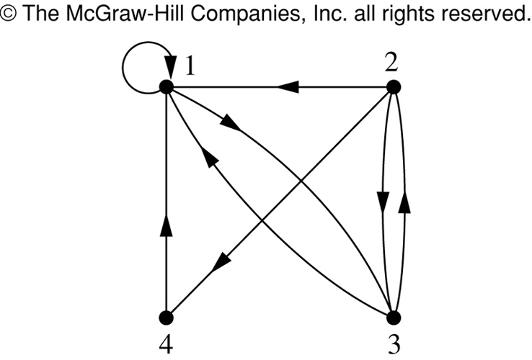
Example
What are the ordered pairs in the relation R represented by the directed graph to the left?
This digraph represents the relation
R = {(1,1), (1,3), (2,1), (2,3), (2,4), (3,1), (3,2), (4,1)}
on the set {1, 2, 3, 4}.

Slide 39
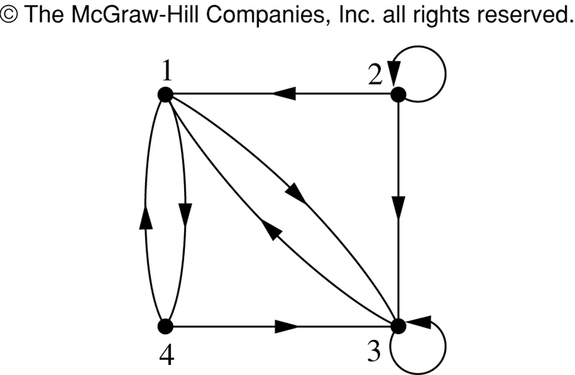
Example
What are the ordered pairs in the relation R represented by the directed graph to the left?
R = {(1,3), (1,4), (2,1), (2,2), (2,3), (3,1), (3,3), (4,1), (4,3)}

Slide 40
Example
According to the digraph representing R:
is (4,3) an ordered pair in R?
is (3,4) an ordered pair in R?
is (3,3) an ordered pair in R?
(4,3) is an ordered pair in R
(3,4) is not an ordered pair in R – no arrowhead pointing from 3 to 4
(3,3) is an ordered pair in R – loop back to itself

Slide 41
Relation Digraphs and Properties
A relation digraph can be used to determine whether the relation has various properties
  Reflexive - must be a loop at every vertex.
  Symmetric - for every edge between two distinct points there must be an edge in the opposite direction.
  Antisymmetric - There are never two edges in opposite direction between two distinct points.
  Transitive - If there is an edge from x to y and an edge from y to z, there must be an edge from x to z.

Slide 42
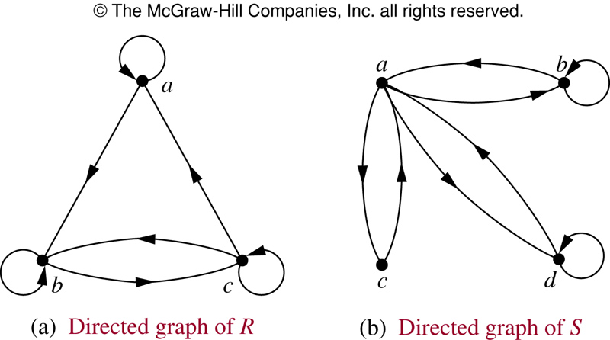
Example
According to the digraph representing R:
is R reflexive?
is R symmetric?
is R antisymmetric?
is R transitive?
R is reflexive – there is a loop at every vertex
R is not symmetric – there is an edge from a to b but not from b to a
R is not antisymmetric – there are edges in both directions connecting b and c
R is not transitive – there is an edge from a to b and an edge from b to c, but not from a to c

Slide 43
Example
According to the digraph representing S:
is S reflexive?
is S symmetric?
is S antisymmetric?
is S transitive?
S is not reflexive – there aren’t loops at every vertex
S is symmetric – for every edge from one distinct vertex to another, there is a matching edge in the opposite direction
S is not antisymmetric – there are edges in both directions connecting a and b
S is not transitive – there is an edge from c to a and an edge from a to b, but not from c to b

Slide 44
Equivalence Relations

Slide 45
Equivalence Relations
A relation on set A is called an equivalence relation if it is:
  reflexive,
  symmetric, and
  transitive

Slide 46
Equivalence Relations
Two elements a and b that are related by an equivalence relation are said to be equivalent.
We use the notation
a ∼ b
to denote that a and b are equivalent elements with repect to a particular equivalence relation.

Slide 47
Example
Let R be a relation on set A, where A = {1, 2, 3, 4, 5} and R = {(1,1), (2,2), (3,3), (4,4), (5,5), (1,3), (3,1)}
Is R an equivalence relation?
We can solve this by drawing a relation digraph:
  Reflexive – there must be a loop at every vertex.
  Symmetric - for every edge between two distinct points there must be an edge in the opposite direction.
  Transitive - if there is an edge from x to y and an edge from y to z, there must be an edge from x to z.

Slide 48
Example
1
2
3
4
5
Is R an equivalence relation? yes

Slide 49
Example – Congruence modulo m
Let R = {(a, b) | a ≡ b (mod m)} be a relation on the set of integers and m be a positive integer > 1.
Is R an equivalence relation?
  Reflexive – is it true that a ≡ a (mod m)}? yes
  Symmetric – is it true that if a ≡ b (mod m) then b ≡ a (mod m)? yes
  Transitive - is it true that if a ≡ b (mod m) and b ≡ c (mod m) then a ≡ c (mod m)? yes

Slide 50
Example
Suppose that R is the relation on the set of strings of English letters such that aRb iff l(a) = l(b), where l(x) is the length of the string x.
Is R an equivalence relation?

Slide 51
Example
Since l(a) = l(a), then aRa for any string a. So R is reflexive.
Suppose aRb, so that l(a) = l(b). Then it is also true that l(b) = l(a), which means that bRa. Consequently, R is symmetric.
Suppose aRb and bRc. Then l(a) = l(b) and l(b) = l(c). Therefore, l(a) = l(c) and so aRc. Hence, R is transitive.
Therefore, R is an equivalence relation.

Slide 52
Equivalence Class
Let R be a equivalence relation on set A.
The set of all elements that are related to an element a of A is called the equivalence class of a.
The equivalence class of a with respect to R is:
  [a]_{R} = {s | (a,s) ∈ R}
  When only one relation is under consideration, we will just write [a].

Slide 53
Equivalence Class
If R is a equivalence relation on a set A, the equivalence class of the element a is:
[a]_{R} = {s | (s, a) ∈ R}
If b ∈ [a]_{R} , then b is called a representative of this equivalence class.

Slide 54
Equivalence Class
Let R be the relation on the set of integers such that aRb iff a = b or a = -b. We can show that this is an equivalence relation.
The equivalence class of element a is
[a] = {a, -a}
Examples:
[7] = {7, -7} [-5] = {5, -5}
[0] = {0}

Slide 55
Equivalence Example
Consider the equivalence relation R on set A. What are the equivalence classes?
A = {1, 2, 3, 4, 5}
R = {(1,1), (2,2), (3,3), (4,4), (5,5), (1,3), (3,1)}
Just look at the aRb relationships. Which elements are related to which?
[1] = {1, 3} [2] = {2}
[3] = {3, 1} [4] = {4}
[5] = {5}

Slide 56
A useful theorem about classes
Let R be an equivalence relation on a set A. These statements for a and b of A are equivalent:
aRb
[a] = [b]
[a] ∩ [b] ≠ ∅

Slide 57
A useful theorem about classes
More importantly:
  Equivalence classes are EITHER
  equal or
  disjoint

Slide 58
Partitions
A partition of a set A divides A into non-overlapping subsets:
  A partition of a set A is a collection of disjoint nonempty subsets of A that have A as their union.
Example 1
A₂
A₁
A₆
A₃
A₅
A₄
Set A

Slide 59
Partitions
Let S be a given set and A={A1,A2,….Am} where each Ai,i-1,2… is a subset of S
Set A is called covering of S and setsA1,A2,… are said to cover S
  A partition of a set A is a collection of disjoint nonempty subsets of A that have A as their union. Then the subsets are called blocks of the partition.
Example 2
S = {a, b, c, d, e, f }
S₁ = {a, d, e}
S₂ = {b}
S₃ = {c, f }
P = {S₁, S₂, S₃}
P is a partition of set S

Slide 60
Example
If S = {1, 2, 3, 4, 5, 6}, then
A₁ = {1, 3, 4}
A₂ = {2, 5}
A₃ = {6}
form a partition of S, because:
  these sets are disjoint
  the union of these sets is S.

Slide 61
Example
If S = {1, 2, 3, 4, 5, 6}, then
A₁ = {1, 3, 4, 5}
A₂ = {2, 5}
A₃ = {6}
do not form a partition of S, because:
  these sets are not disjoint (5 occurs in two different sets)

Slide 62
Example
If S = {1, 2, 3, 4, 5, 6}, then
A₁ = {1, 3}
A₂ = {2, 5}
A₃ = {6}
do not form a partition of S, because:
  the union of these sets is not S (since 4 is not a member of any of the subsets, but is a member of S).

Slide 63
Example
If S = {1, 2, 3, 4, 5, 6}, then
A₁ = {1, 3, 4}
A₂ = {2, 5}
A₃ = {6, 7}
do not form a partition of S, because:
  the union of these sets is not S (since 7 is a member of set A₃ but is not a member of S).

Slide 64
Constructing an Equivalence Relation from a Partition
Given set S = {1, 2, 3, 4, 5, 6} and a partition of S,
A₁ = {1, 2, 3}
A₂ = {4, 5}
A₃ = {6}
then we can find the ordered pairs that make up the equivalence relation R produced by that partition.

Slide 65
Constructing an Equivalence Relation from a Partition
The subsets in the partition of S,
A₁ = {1, 2, 3}
A₂ = {4, 5}
A₃ = {6}
are the equivalence classes of R. This means that the pair (a,b) ∈ R iff a and b are in the same subset of the partition.

Slide 66
Let’s find the ordered pairs that are in R:
A₁ = {1, 2, 3} → (1,1), (1,2), (1,3), (2,1),
(2,2), (2,3), (3,1), (3,2), (3,3)
A₂ = {4, 5} → (4,4), (4,5), (5,4), (5,5)
A₃ = {6} → (6,6)
So R is just the set consisting of all these ordered pairs:
R = {(1,1), (1,2), (1,3), (2,1), (2,2), (2,3), (3,1), (3,2), (3,3), (4,4), (4,5), (5,4), (5,5), (6,6)}

Slide 67
Compatibility Relation
A relation R in set A is said to be a compatibility relation if it is reflexive and symmetric.
Example: Let a={ball, bed, dog, let, egg} and the relation R be given by
R = {(x, y) / x, y ϵ A & x R y if x and y contain some common letter}

Slide 68
Maximal Compatibility Relation
Let X be a set and R is a compatibility relation on X.A is a subset of X is called a maximal compatibility block if any element of A is compatible to every other element of A and no element of X –A is compatible to all the elements of A.

Slide 69
Partial ordering
A relation R on a set S is called a partial ordering or partial order if it is:
  reflexive
  antisymmetric
  transitive
A set S together with a partial ordering R is called a partially ordered set, or poset, and is denoted by (S, R).

Slide 70
Example
Let R be a relation on set A. Is R a partial order?
A = {1, 2, 3, 4}
R = {(1,1), (1,2), (1,3), (1,4), (2,2),
(2,3), (2,4), (3,3), (3,4), (4,4)}

Slide 71
Example
Is R a partial order?
R = {(1,1), (1,2), (1,3), (1,4), (2,2), (2,3), (2,4), (3,3), (3,4), (4,4)}
To be a partial order, R must be reflexive, antisymmetric, and transitive.
R is reflexive because R includes (1,1), (2,2), (3,3) and (4,4).
R is antisymmetric because for every pair (a,b) in R, (b,a) is not in R (unless a = b).
R is transitive because for every pair (a,b) in R, if (b,c) is in R then (a,c) is also in R.

Slide 72
Example
So, given
A = {1, 2, 3, 4}
R = {(1,1), (1,2), (1,3), (1,4), (2,2),
(2,3), (2,4), (3,3), (3,4), (4,4)}
R is a partial order, and
(A, R) is a poset.

Slide 73
Example
Is the “≥” relation a partial ordering on the set of integers?
  Since a ≥ a for every integer a, ≥ is reflexive
  If a ≥ b and b ≥ a, then a = b. Hence ≥ is anti-symmetric.
  Since a ≥ b and b ≥ c implies a ≥ c, ≥ is transitive.
  Therefore “≥” is a partial ordering on the set of integers and (Z, ≥) is a poset.

Slide 74
Comparable / Incomparable
In a poset the notation a ≼ b denotes (a, b) ∈ R
  The “less than or equal to” (≤)is just an example of partial ordering
The elements a and b of a poset (S, ≼) are called comparable if either a≼b or b≼a.
The elements a and b of a poset (S, ≼) are called incomparable if neither a≼b nor b≼a.
In the poset (Z⁺, |):
  Are 3 and 9 comparable? Yes; 3 divides 9
  Are 5 and 7 comparable? No; neither divides the other

Slide 75
Total Order
We said: “Partial ordering” because pairs of elements may be incomparable.
If every two elements of a poset (S, ≼) are comparable, then S is called a totally ordered or linearly ordered set and ≼ is called a total order or linear order.
A totally ordered set is also called a chain.

Slide 76
Total Order
The poset (Z, ≤) is totally ordered. Why?
Every two elements of Z are comparable; that is, a ≤ b or b ≤ a for all integers.
The poset (Z⁺, |) is not totally ordered. Why?
It contains elements that are incomarable; for example 5 | 7.
/

Slide 77
Lexicographic Order
The order in which words in a dictionary are arranged is known as alphabetical order or lexicographic order.
We say that (a₁, a₂) is less than (b₁, b₂) – that is, (a₁, a₂) lR (b₁, b₂)
either if a₁!=a₂ and a₁< a₂
or a₁=a₂ ,b₁!=b₂ and b₁< b₂

Slide 78
In the poset poset (Z × Z, ≼),
is (3, 5) lR (4, 8)? yes
is (3, 8) lR (4, 5)? yes
is (4, 9) lR (4, 11)? Yes
is (4, 9) lR (4, 5)? No
is (1, 7) lR (3, 4)?

Slide 79
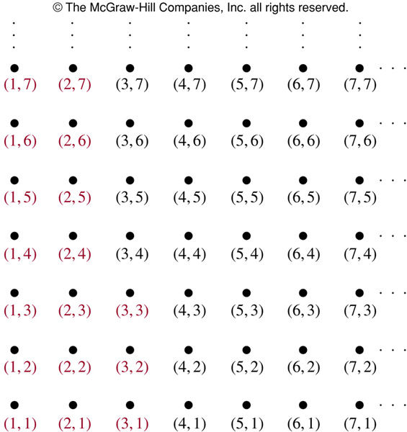
Lexicographic Order
The ordered pairs in red are all less than (3,4).

Slide 80
Those are the actual rules by which words are listed in order in the dictionary.
For example, discreet  discrete, because these strings differ in the 7th position, and e  t.
Also, discreet  discreetness, because these strings agree for the first 8 characters (the length of the shorter string), but the second string has more letters.
Finally, discrete  discretion, because these strings differ in the 8th position, and e  i.

Slide 81
Hasse Diagram
A Hasse diagram is a graphical representation of a poset.
Since a poset is by definition reflexive and transitive (and antisymmetric), the graphical representation for a poset can be compacted.
For example, why do we need to include loops at every vertex? Since it’s a poset, it must have loops there.

Slide 82
Constructing a Hasse Diagram
Start with the digraph of the partial order.
Remove the loops at each vertex.
Remove all edges that must be present because of the transitivity.
Arrange each edge so that all arrows point up.
Remove all arrowheads.

Slide 83
Example
Construct the Hasse diagram for ({1, 2, 3}, ≤)
3
2
1
3
2
1
1
2 3
1
2 3
1
2 3

Slide 84
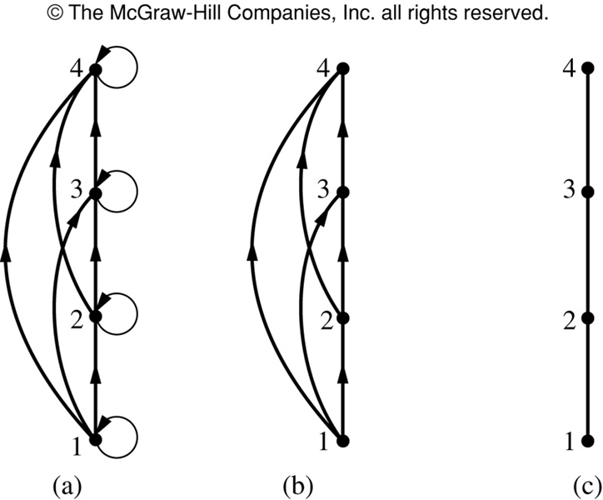
Hasse Diagram Example
Steps in the construction
of the
Hasse diagram
for
({1, 2, 3, 4}, ≤)

Slide 85
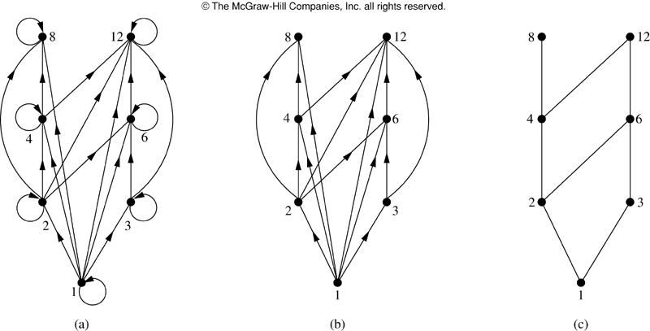
Hasse Diagram Example
Steps in the construction of the Hasse diagram for
({1, 2, 3, 4, 6, 8, 12}, |)

Slide 86
Hasse Diagram Terminology
Let (S, ≼) be a poset.
a is maximal in (S, ≼) if there is no b∈S such that a≼b. (top of the Hasse diagram)
a is minimal in (S, ≼) if there is no b∈S such that b≼a. (bottom of the Hasse diagram)

Slide 87
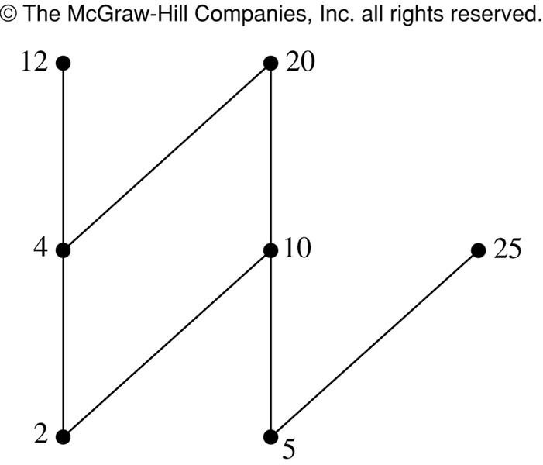
Hasse Diagram Terminology
Which elements of the poset ({, 2, 4, 5, 10, 12, 20, 25}, | ) are maximal? Which are minimal?
The Hasse diagram for this poset shows that the maximal elements are: 12, 20, 25
The minimal elements are: 2, 5

Slide 88
Hasse Diagram Terminology
Let (S, ≼) be a poset.
a is the greatest element of (S, ≼) if b≼a for all b∈S…
  It must be unique
a is the least element of (S, ≼) if a≼b for all b∈S.
  It must be unique

Slide 89
Hasse Diagram Terminology
Does the poset represented by this Hasse diagram have a greatest element? If so, what is it? Does it have a least element? If so, what is it?
The poset represented by this Hasse diagram does not have a greatest element, because the greatest element must be unique.
It does have a least element, a.
b c d
a

Slide 90
Hasse Diagram Terminology
Does the poset represented by this Hasse diagram have a greatest element? If so, what is it? Does it have a least element? If so, what is it?
d e
c
a b
The poset represented by this Hasse diagram has neither a greatest element nor a least element, because they must be unique.

Slide 91
Hasse Diagram Terminology
Does the poset represented by this Hasse diagram have a greatest element? If so, what is it? Does it have a least element? If so, what is it?
The poset represented by this Hasse diagram does not have a least element, because the least element must be unique.
It does have a greatest element, d.
d
c
a b

Slide 92
Hasse Diagram Terminology
Does the poset represented by this Hasse diagram have a greatest element? If so, what is it? Does it have a least element? If so, what is it?
d
b c
a
The poset represented by this Hasse diagram has a greatest element, d.
It also has a least element, a.

Slide 93
Hasse Diagram Terminology
Let A be a subset of (S, ≼).
If u∈S such that a≼u for all a∈A, then u is called an upper bound of A.
If l∈S such that l≼a for all a∈A, then l is called an lower bound of A.
If x is an upper bound of A and x≼z whenever z is an upper bound of A, then x is called the least upper bound of A.
  It must be unique
If y is a lower bound of A and z≼y whenever z is a lower bound of A, then y is called the greatest lower bound of A.
  It must be unique

Slide 94
Example
h j
g f
d e
b c
a
Maximal: h, j
Minimal: a
Greatest element: None
Least element: a
Upper bound of {a,b,c}: e, f, j, h
Least upper bound of {a,b,c}: e
Lower bound of {a,b,c}: a
Greatest lower bound of {a,b,c}: a

Slide 95
Lattices
A lattice is a partially ordered set in which every pair of elements has both a least upper bound and greatest lower bound.
f
e
c d
b
a
h
e f g
b c d
a

Slide 96
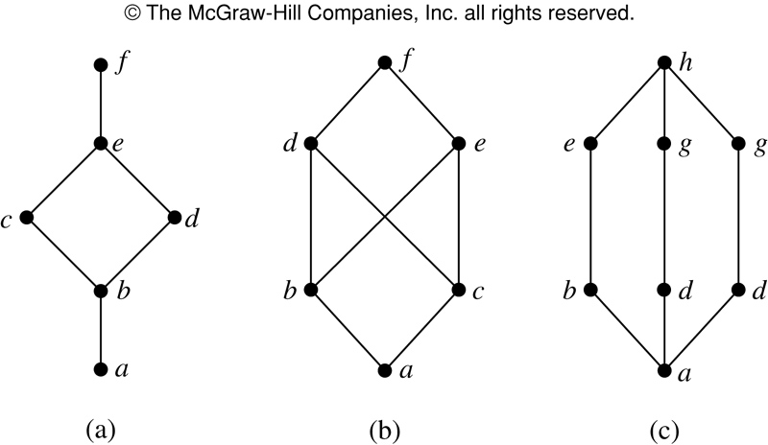
Lattice example
Are the following three posets lattices?

Slide 97
Lattice example
Are the following three posets lattices?
(a) Yes
(b) No; elements b and c have no least upper bound.
(c) Yes

Slide 98
Conclusion
In this chapter we have studied:
Relations and their properties
How to represent relations
Closures of relations
Equivalence relations
Partial orderings

